Slide 1
Project Title Here
Your Name
ECE 18-765
Spring 2015

Slide 2

Implementation Overview
Describe what you have implemented
  Boundary scan
  Internal scan?
  BIST
  Extra I/O
  Etc.
Use one or two slides to describe the unique features of your design
  We all know about boundary scan, internal scan, the TAPC, etc.
  What did you do differently? What makes your approach better/worse?

Slide 3

Test Generation (4 slides max)
Describe how you generated your test patterns
  Manual test generation?
  Hope/Atalanta?
  Encounter Test?
  Other?

Slide 4

Validation (use 2-3 slides as needed)
Describe how you ensured that s9234 still operated correctly after you inserted your DFT features.
  Simulated random sequences using VCS/ET and compared original s9234 outputs with your modified version of s9234?
  Performed equivalence checking? (I would be impressed)
  Performed model checking? (I would be really impressed)
  Other? (I hope you won’t say we “eyeballed both netlists”)
Describe how you measured fault coverage of your boundary scan test session
  Essentially, you should use ET to simulate your s9234 and a test sequence file of your own making.
  How much CPU time did it take to complete the fault simulation?
  Any other interesting tidbits you would like to share?

Slide 5

Results (1 slide only)
Number of BIST cycles (B) | Value
Number of non-BIST cycles (S) and tester channels (T_{S}) | (Value, Value)
Total number of input and outputs added (P) | Value
Number of tester channels (T) | Value
Total number of normal (D_{N}) and reset (D_{R}) flip-flops added | (Value, Value)
Total number of gate inputs added to s9234 (G) | Value
Total Cost (C) (Use metric in the project handout) | Value

Slide 6
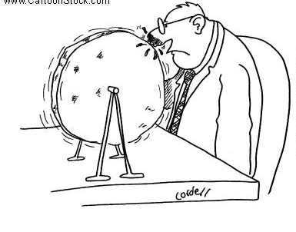
Unfinished Items
Describe what other items you have to finish?
  It is often the case that everything is NOT yet done.
  So explain here succinctly what leftover items you need to complete.
  This is necessary so that we can completely understand what is real and what is still yet unfinished.

Slide 7

Conclusions
Do you think you made good choices?
  What would you keep the same?
  What would you do differently (if anything)?

